Slide 1


Week 8: Epistemic stance and the stance triangle
Ryan Ka Yau Lai
University of California, Santa Barbara

Slide 2


While we’re waiting …
Open SBC007 on Rezonator
Preferably a previously saved version
Choose left-justified grid view
Choose rez mode
Note today’s codeword and question on the board
Sit with your group members
Shameless plug: You can still enroll in LING 194 Visualising language in conversational interactions, which I teach in summer!
Apply for a scholarship here: https://ucsb.my.site.com/success/s/apply-for-summer-scholarship

Slide 3

Question for today
Find one example of a line that contains an expression of epistemic stance, and explain what kind of stance is being expressed with respect to both linguistic form and sequential position.
[Bonus: Cast your answer in terms of the stance triangle framework.]

Slide 4
In this class, you will …
Practise
Practise annotating resonance in SBC007 and justifying your response
Navigate
Navigate between groups of resonances in Rezonator using the Clique pane
Understand
Understand the three components of the stance triangle
Distinguish
Distinguish between different motivations for absence of resonance: Expressing a stance differential vs. ellipsis.
Appreciate
Appreciate the diversity of ways to express stance alignment in language
Identify
Identify expressions of epistemic stance in conversation
Use
Use epistemic access to help recognise actions in conversation

Slide 5

Before we start …
Any questions about resonance?
Can you identify instances of high resonance vs. low resonance, in similar discourse contexts? Why do they differ?
Which is more likely to be part of a high resonance clique: a backchannel or a full turn? Why?
Which is more likely to contain an exception to resonance parellism (in high-resonance cliques): a question-answer sequence, or another high-resonance sequence? Why?
Which kinds of repair are most likely to contain high resonance? Why?
What parts of the repair sequence involve the most resonance? Why?

Slide 6
Epistemic access
Epistemic access: Who knows their stuff more about something
Epistemic stance: How do people portray their and others’ epistemic stance?

Slide 7
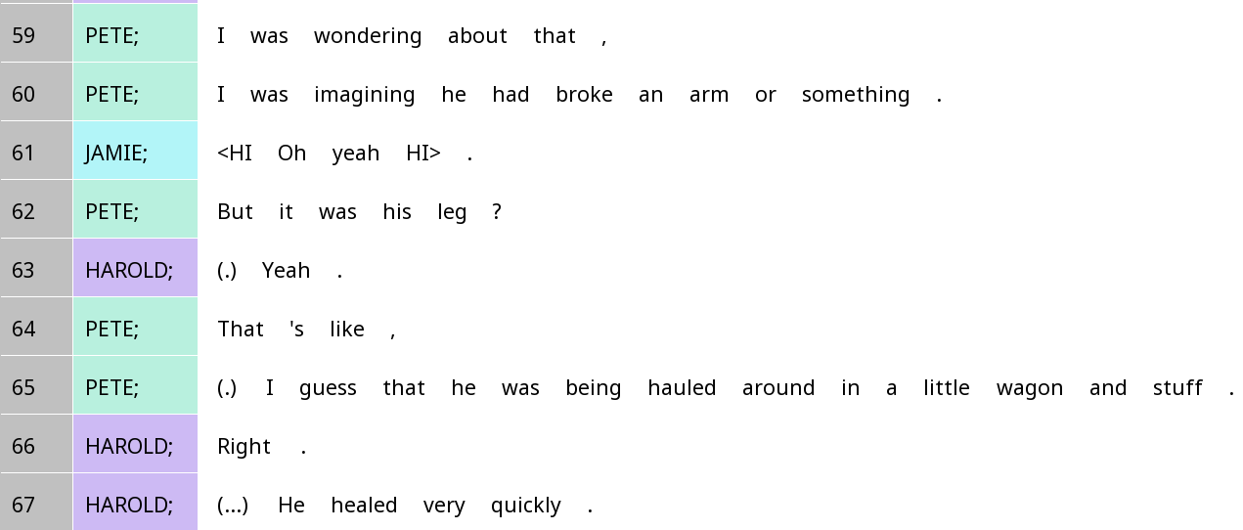
Who ‘knows their stuff’ more about the incident? How can you tell?

Slide 8
Epistemic access and question-answer pairs
Generally: The person who is being asked something has more privileged epistemic access (i.e. should know their stuff more) about the thing being asked about
By asking a question, we usually take an epistemic stance that we know less about something
When Prof Du Bois asks you a question in class, what is the epistemic stance taken? What is the actual epistemic access like?

Slide 9
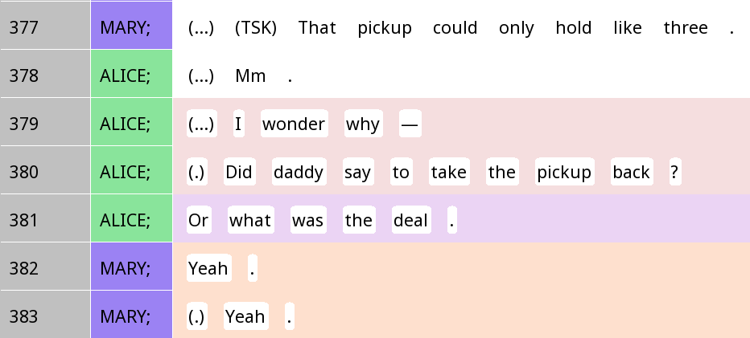
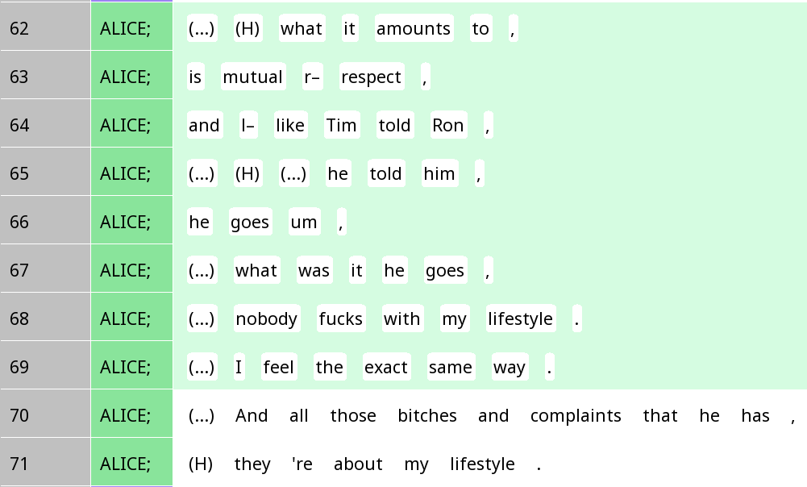
Epistemic access as a pragmatic cue for recognising actions

Slide 10
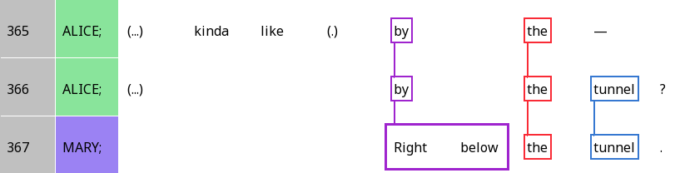
Resonance and epistemic authority
 | A | B | C-E |  |  | F
Alice | (Alice) | kinda like | by | the | tunnel | ? (seeking confirmation)
Mary | (Mary) | (higher authority) | right below | the | tunnel | . (reserved agreement)

Slide 11
Epistemic gradients
Do you think Alice is characterising herself as having higher epistemic authority on line 379 and 381, or on line 380?

Slide 12
Epistemic gradients
Alice: K-
Mary: K+
Yeah.
Did daddy say to take the pickup back?
What was the deal?

Slide 13
Assessments
When you give your value judgements about something: Saying it’s good or bad, beautiful or ugly …
We’ll talk more about this next week
For now, we focus on epistemic access in assessments

Slide 14
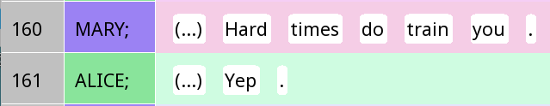
Leads and follows
Stance lead
Stance follow
Question: Who generally has higher epistemic access, the leader or the follower?

Slide 15
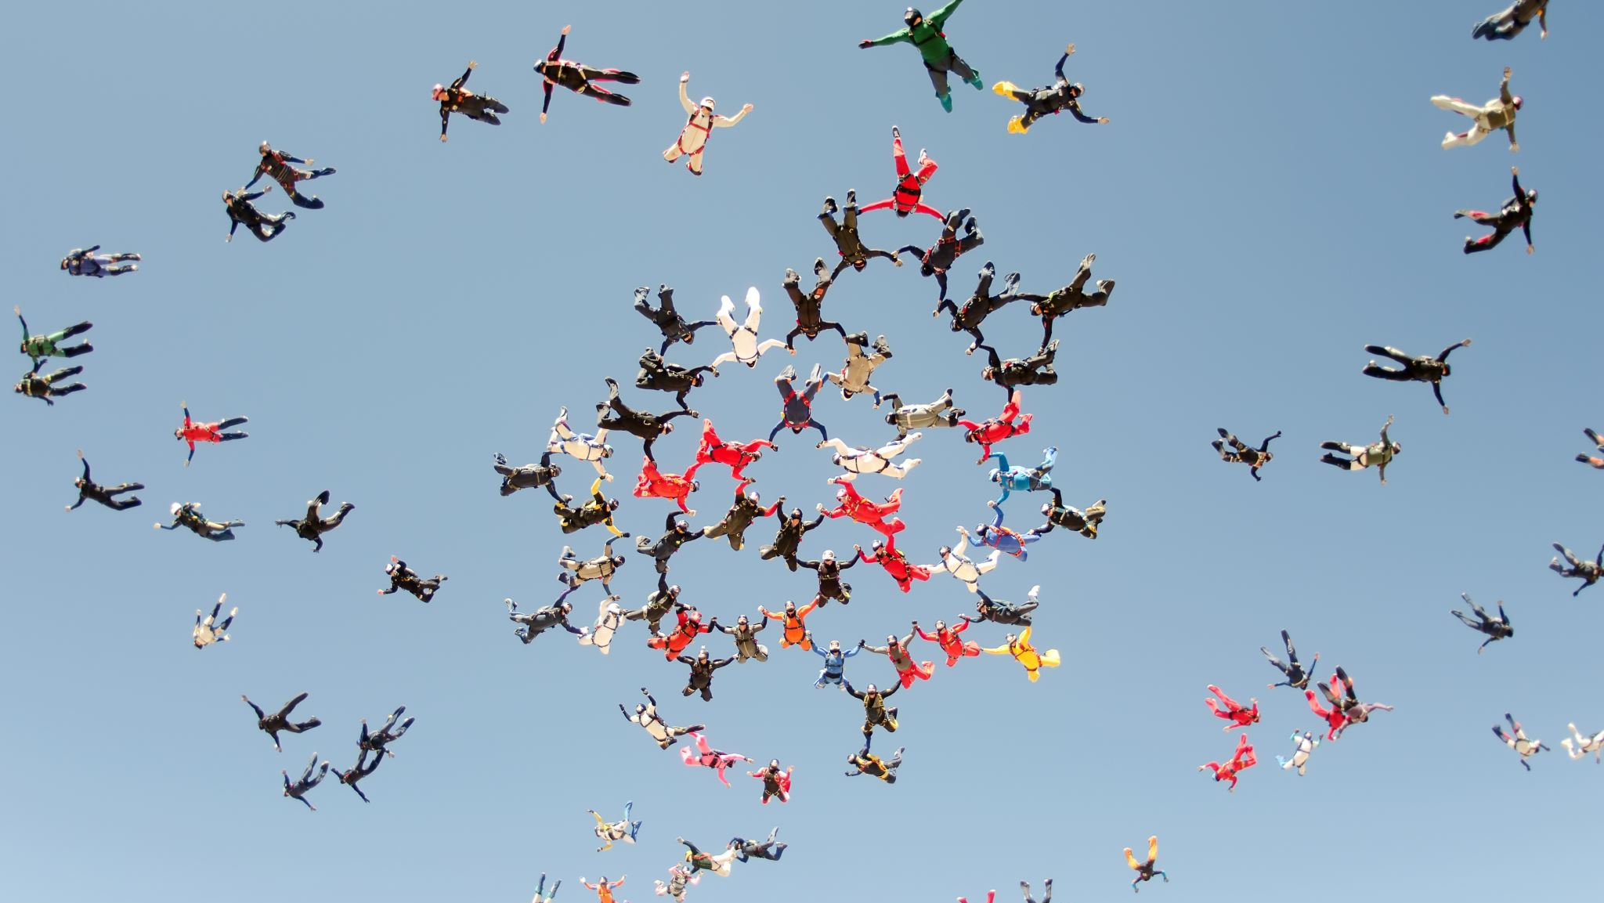
Generally…
The person who provides the first assessment (first pair part) has higher epistemic authority (K+)
The person who provides the second assessment (second pair part) has lower epistemic authority (K-)
But speakers have all sorts of ways to get out of this general pattern
Epistemic upgrading: I know more than you might expect of my position
Epistemic downgrading: I know less than you might expect of my position

Slide 16
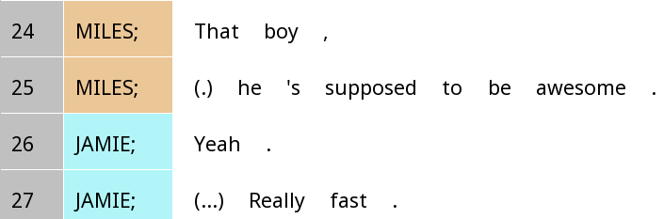
First position epistemic downgrade
‘Supposed to’: Positioning himself as having less epistemic authority, getting that idea from other sources

Slide 17
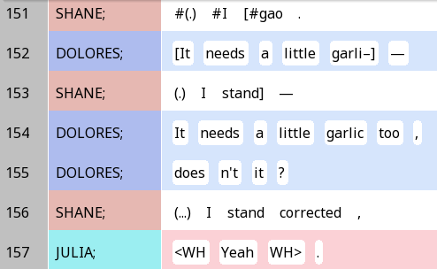
First position epistemic downgrade: tag questions
Question: If a tag question appears in second position (e.g. if Julia had said Right?, what epistemic stance does that express?

Slide 18
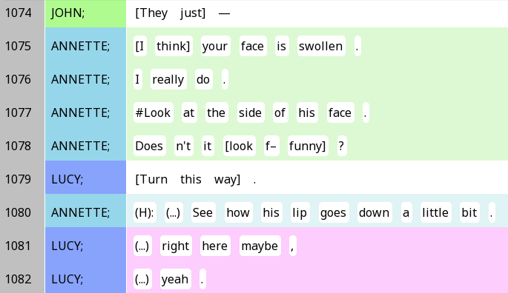
First position epistemic upgrade: Negative questions
Even though this example also uses doesn’t it, it is an upgrade instead of a downgrade!

Slide 19
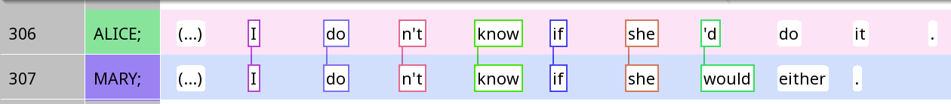
Second position epistemic upgrade: Resonance
If Mary had just said, ‘Right.’, or ‘True.’, how would Mary’s expressed level of epistemic authority change?

Slide 20
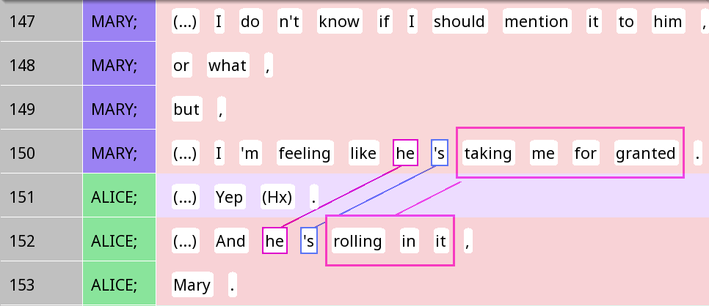
Second position epistemic upgrade: Elaborating on a ‘yeah’

Slide 21
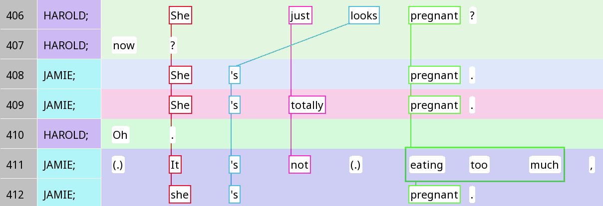
What is all the linguistic evidence for epistemic access here?

Slide 22
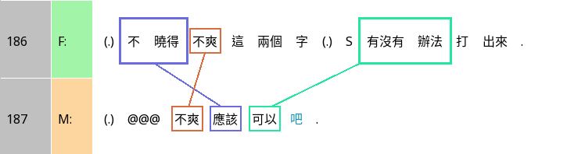
Epistemic downgrade in Chinese: 吧 ba
I don’t know if the words ‘not cool’ can be typed out.
‘Not cool’ should be fine ba.
How does F downgrade her epistemic access?
How does M respond to that?

Slide 23
Positions and upgrade/downgrade (from Heritage and Raymond)
 | First position | Second position
Downgrade | Words like 'seems', 'sounds', 'appears', 'looks’ … that name a source for the info Tag questions 'isn't it?', 'right?
Unmarked (‘normal’) | Simple declarative sentence (It’s nice.) | Simple declarative, e.g. ‘Sure is.’
Upgrade | Negative questions ‘Isn’t that nice?’ | Confirmation + Agreement ‘It is, yeah’ Oh-prefacing ‘Oh that’s nice’ Tag questions 'isn't it?', 'right?’ Negative questions ‘Isn’t that nice?’

Slide 24

Your turn!
Look at one example you have (from resonance, repair, q&a)
Who has more epistemic access?
How do you know?
Look for instances of epistemic upgrading and downgrading in your data
What cues did you pick up on to find this?

Slide 25
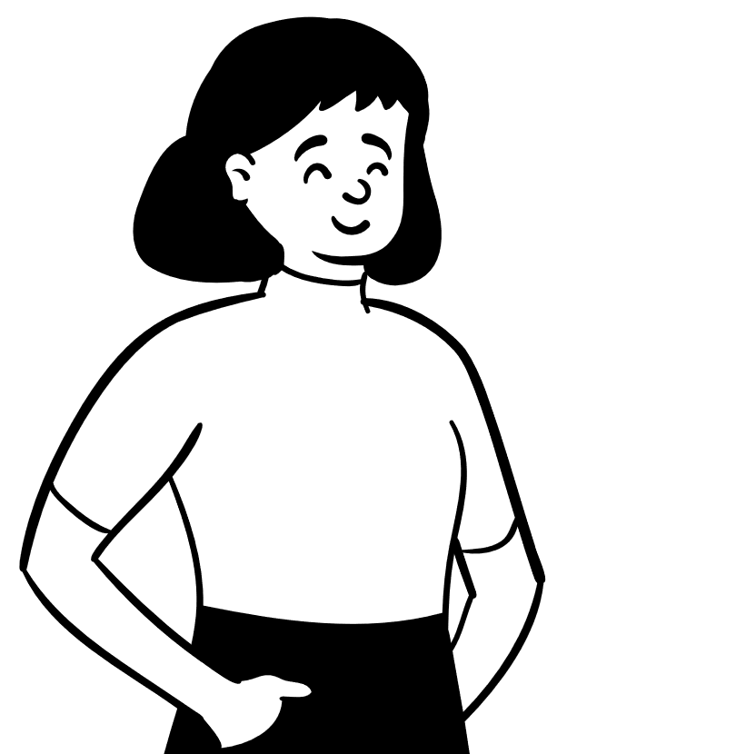
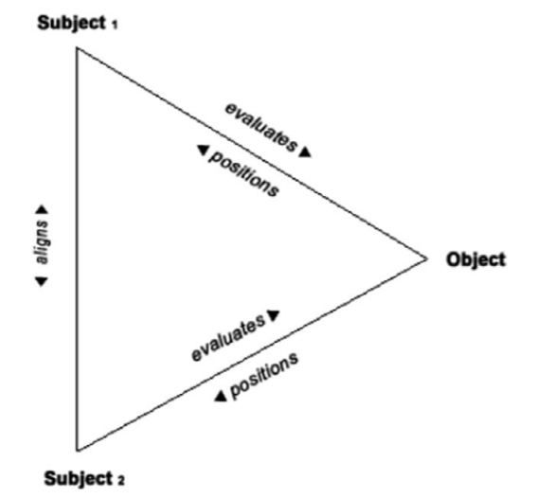



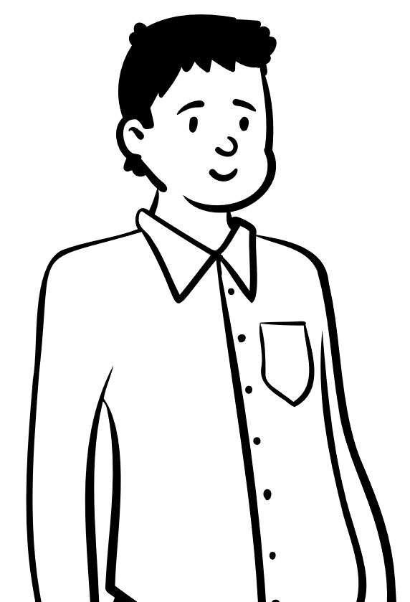

Stance
Stance subjects: The people taking stances
Stance objects: The phenomenon that people are taking a stance about
Evaluation & positioning: Stance subjects’ subjectivity towards the object (more later on)
Alignment: Do people agree, disagree, or have other relationships with the other person’s stance?

Slide 26
Diagraph form of the triangle (lines 306-307)
 | Stance subject | Position |  |  | Stance object |  |  |  |  | Alignment
Alice | I | do | n’t | know | if | she | ‘d | do | it
Mary | I | do | n’t | know | if | she | would |  |  | either
Stance subject
Alice
Position
Uncertainty
Alignment
Agreement
Stance object
if she’d do it
Position
Uncertainty
This is an example of epistemic stance, about your knowledge of the stance object
Stance subject
Mary

Slide 27
Positioning vs evaluation
Positioning: How the stance subject characterises their feeling towards the stance object (it’s mainly about themselves)
Evaluation: What the stance subject thinks the stance object is like (it’s mainly about the stance object)

Slide 28
Identifying positioning vs evaluation
Positioning | Evaluation
I think that’s great! I know it will fail. I’m sick of this! … | That sucks! Wow, this is cool! This will never work. …

Slide 29
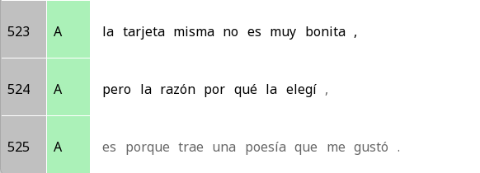
Positioning vs evaluation: Two sides of the same coin?
Evaluation
The card itself is not very pretty,
The card itself is not very pretty,
but the reason why I chose it,
Positioning
Is because it carries a poem that I liked.

Slide 30
Diagraph form of the triangle (lines 523-525)
Stance subject
A
Stance subject
A
Evaluation
Not very pretty
Positioning
Liking
Stance object
The card itself
Stance object
The poem
Note: We don’t always get all parts of the stance triangle explicitly in the data. That’s OK! (In this case, the transcription cuts off after line 525, so we don’t get the alignment,)

Slide 31
Your turn!
Find one expression of stance in SBC007.
Name the stance subject, stance object, positioning/evaluation, and alignment.

Slide 32

Question: When people do not repeat words when resonating, what are they trying to say?

Slide 33
There’s a few possibilities …
They want to express a different opinion (stance differential)
They’re leaving out stuff that’s obvious and inferable (ellipsis)
They’re leaving out conjunctions that no longer matter
… The possibilities are endless

Slide 34
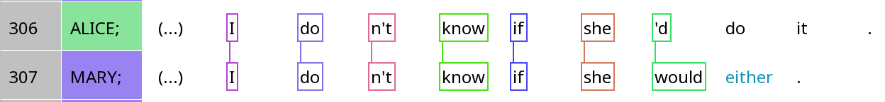
When silence is ellipsis
 | Stance subject | Position |  |  | Stance object |  |  |  |  | Alignment
Alice | I | do | n’t | know | if | she | ‘d | do | it
Mary | I | do | n’t | know | if | she | would | (do) | (it) | either
Question: Do you think ellipsis is more likely with frame resonance or focal resonance?

Slide 35
When silence is a stance differential
 | Stance subject | Position | Stance object |  |  | Alignment
Alice | (Alice) | kinda like | by | the | tunnel | ? (seeking confirmation)
Mary | (Mary) | (higher authority) | right below | the | tunnel | . (reserved agreement)

Slide 36
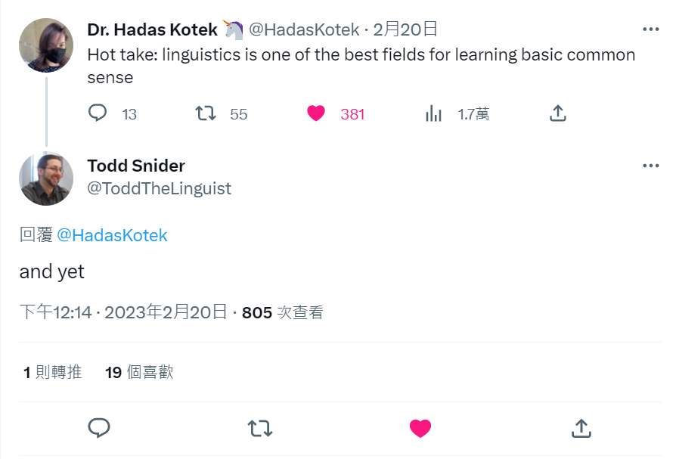
When it’s both …

Slide 37
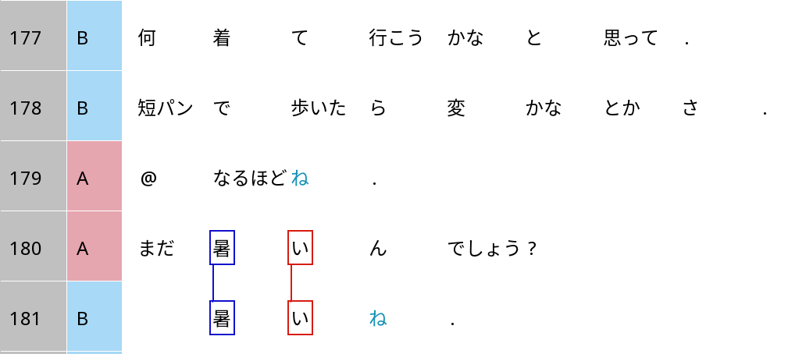
Grammaticalised stance alignment in Japanese: ne
I thought, what should I wear to go?
If I walk around in shorts, would it be weird and stuff?
I see ne.
It’s because it’s perhaps still hot (where B is)?
It’s still hot ne.

Slide 38
Grammaticalised stance alignment in Japanese: ne
It’s because it’s perhaps still hot (where B is)?
It’s still hot ne.
Stance object |  |  | Evaluation | Stance alignment
まだ mada | 暑い atsui | ん n | でしょう deshou | ? ?
still | hot | explanation | ‘Unsure, but I think yes’ | ‘I defer to your opinion.’
 | 暑い atsui |  |  | ね。 ne.
 | hot |  | No uncertainty | ‘Just as you thought.’

